Slide 1
LAKSHMANDEV VK
NOMINATION FOR BEST OUT GOING STUDENT AWARD

Slide 2
ACADEMICS
92.6%
96.66%
94.4%
94.5%
First Semester
Second Semester
Third Semester
Second Rank
Second Rank
Second Rank
97.55%
Fourth Semester
Fifth Semester
Second Rank
First Rank

Slide 3
SKILLS….
PYTHON
HTML , CSS & JS
PHP , MY SQL
JAVA
C

Slide 4
THE CURRICULUM
Internship
UI & UX
Science Association
Internship Completed at Craper Soft
Program Attended: Quantum of Scientia -2022 at PSG PTC Science Association
Participated in One-day workshop on "UI/UX Designing", at PSG PTC

Slide 5
THE CURRICULUM
Game Design
WORK SHOP
National level Conference
One-day workshop on "Games Designing", at PSG PTC
Emerging Trends in Defence, Agriculture & Artificial Intelligence Sector - PSG PTC
Computational Biology: The Power of Bioinformatics, at PSG ITECH

Slide 6
THE CURRICULUM
WORK SHOP
Skill Development & Entrepreneurship
on "Photoshop" at PSG PTC
IHFC- Technology Innovation Hub of IIT Delhi
I AM ONE OF THE VOLUNTEER IN THE NBA

Slide 7
EXTRA CURRICULAR
Paper Presentation
Project Presentation
SANKARA POLYTECHNIC COLLEGE
NACHIMUTHU POLYTECHNIC COLLEGE
Topic Silent Sound Technology [ECE Dept]
Project Presentation is held by NPC college as an Symposium
KIT COLLEGE
Topic Big Data
[CSE Dept]
SAKTHI POLYTECHNIC COLEGE
Project Presentation is held by SPC college as an Symposium

Slide 8
EXTRA CURRICULAR
Project Presentation
KPR INSTITUTION
INTERNATION PROJECT PRESENTATION IS HELD BY THE KPR INSTITUTION

Slide 9
AWARDS
2ND PRIZE
3RD PRIZE
1st PRIZE
I have received 2nd prize for presenting SST at Sankara polytechnic college
I have received 1st place at the Sakthi polytechnic college for presenting my project
BEST PROJECT
I have received 3rd place for presenting my project ar the nachimuthu polytechnic college
BEST PROJECT AWARDED BY THE KPR INTISTUTION [INTERNATION PRESENTATION]

Slide 10
MY PROGRESS
TALANTREK
CIICP-SPCU
TELEPHONE BOOK
FACULTY ENTRY
Presenting our college SU 2022
For PSG–PTC INSITUTIONS
FOR PSG-PTC INSITUTIONS
FOR PSG-PTC INSITUTIONS

Slide 11
OTHER PROJECTS
Virtual Steering
Eye Tracking mouse
Virtual drag and drop
It can be able to move the steering without any physical obj By Python
This is done by Python
It also done by python
Remainder application
Working in AR
It is one of the application that can be able to done by the mobile application
This is my final year project with in the purpose of education
[THIS IS DEVELOPED BY ME]

Slide 12

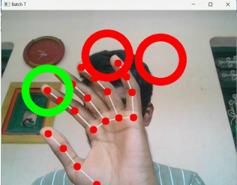

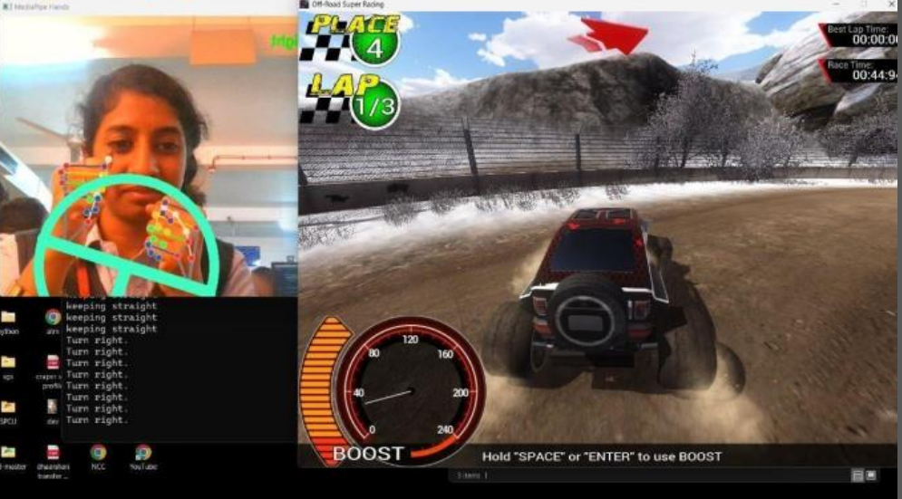
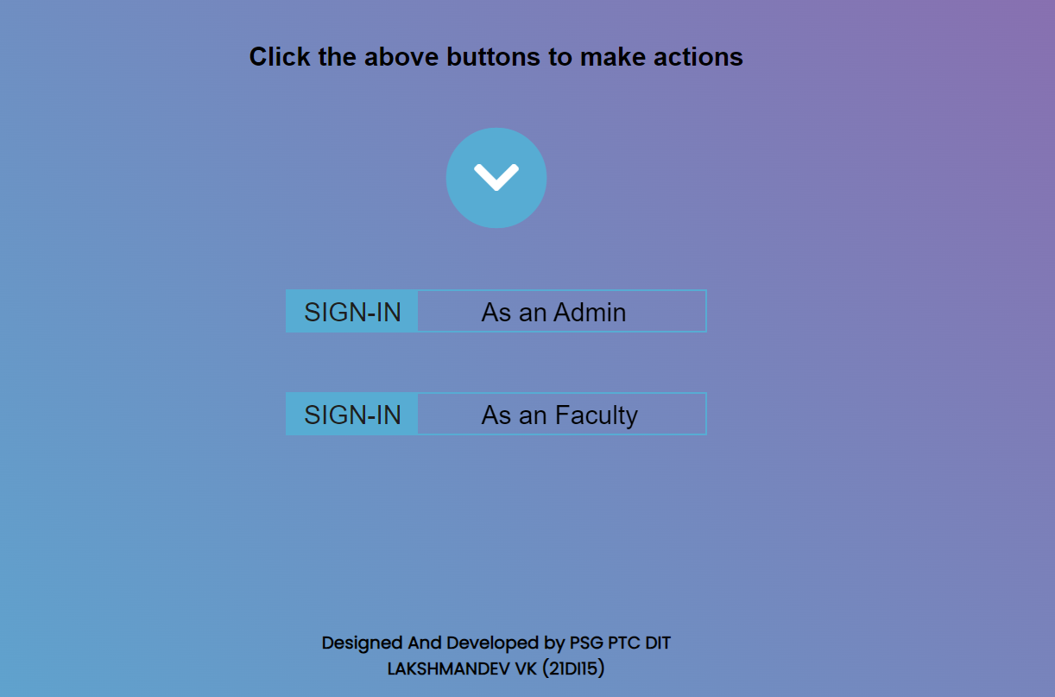

Slide 13

THANK YOU

